Slide 1

Deep Learning MSiA 432
Theory and Applications

Slide 2
Urban Sound Classification
Urban Sound Classification Project
We use deep learning to classify urban sounds from the UrbanSound8K dataset. Urban environments are immersed in sounds of transportation, construction, human voice, music, animals, and nature. The need to understand urban environment acoustics is a subject of increased interest recently and has wide range of applications in multimedia sensor networks, music industry, assistive technologies for hearing impaired, etc.
Group members:
Aakanksha Sah
Aditya Gudal
Aditya Tyagi
Bhavya Kaushik
Manish Kumar
Shreyashi Ganguly
Srividya Ganapathi

Slide 3
Problem Statement
The objective of this project is to use deep learning to classify urban sounds from the UrbanSound8k dataset. We have 10 classes of urban sounds and we predict probabilities for a given audio clip belonging to each of the classes. The model performance evaluation metric is classification accuracy.
Hearing impaired individuals, security system companies and manufacturing companies can benefit from this solution.
Whilst there is a large body of research in related audio fields such as speech and music, work on the classification of environmental sounds is comparatively scarce.
Observing the recent advancements in the field of image classification where convolutional neural networks are used to classify images with high accuracy and at scale, these techniques can be extended to other domains, such as sound classification.

Slide 4
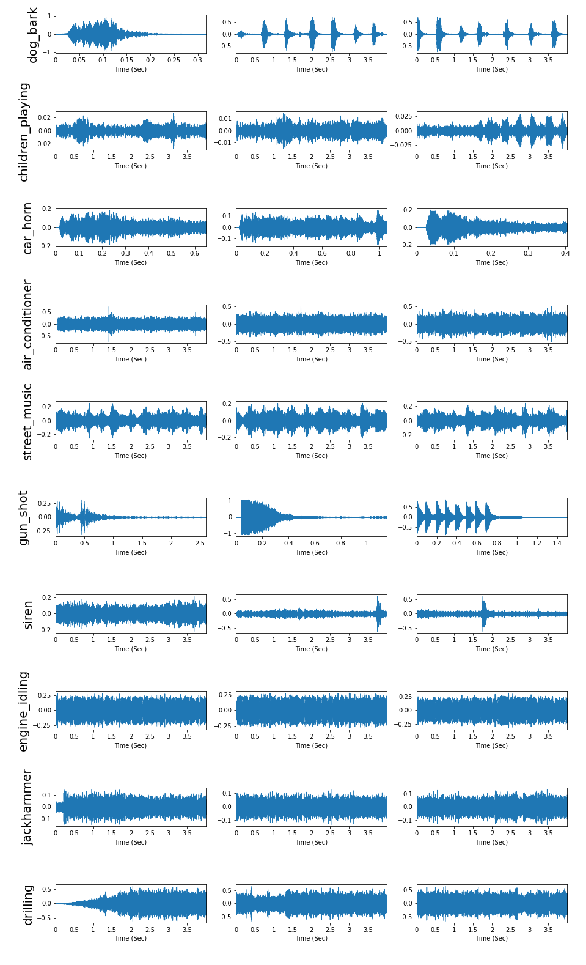

Dataset
Dataset – The UrbanSound8K dataset consists of 8732 labeled sound excerpts (=<4s) of urban sounds. There are 10 classes: air_conditioner, car_horn, children_playing, dog_bark, drilling, enginge_idling, gun_shot, jackhammer, siren, and street_music. Along with the individual files in .wav format corresponding to audio clips, a metadata(.csv) file is provided which tags each file to its class labels.
Example – Dog Bark
Human Accuracy – A human with a decent hearing ability can easily identify the corresponding class of sound. The classes ‘jackhammer’ and ‘engine_idling’ created confusion and were the primary reason for misclassifications by humans. The classes ‘gunshot’, ‘air_conditioner’ and ‘drilling’ were also problematic for humans. The other classes like ‘dog bark’, ‘car horn’ etc. were easier to identify. In general the human accuracy rate can be estimated to be in the range 95% to 98%.
Waveforms: 3 samples of each category

Slide 5
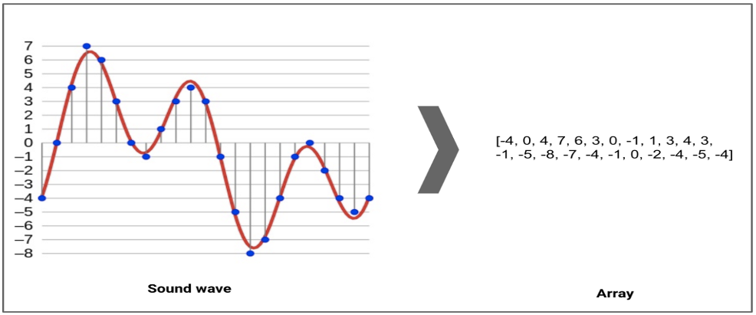
Dataset - Preprocessing
Preprocessing –
We iterated through each of the audio sample files and extracted the number of audio channels, sample rate, and bit-depth using Librosa package in Python. The number of audio channels was converted to 1 by merging signals, the sample rate was converted to 22.05 kHz and the bit depth was normalized so that the values were in the range of -1 to 1.

Slide 6
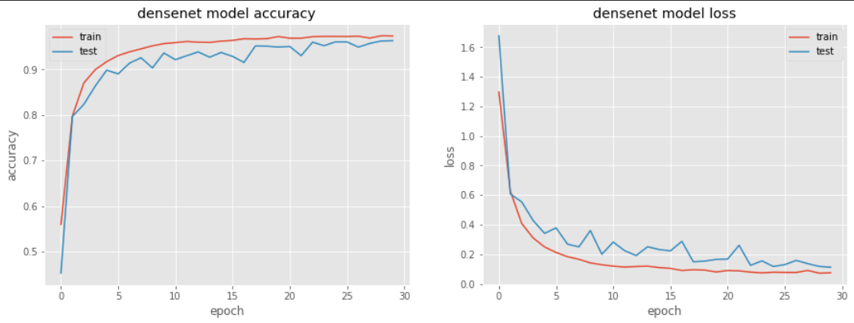
Dataset - The Challenges
The dataset is of decent size, the total size of the data in a compressed format is 5.7GB.
The audio file properties like the sampling rate, the number of channels, and the bit depth weren’t uniform over all the observations and required standardization.
Although all the audio clips were clipped at 4s, they still had different durations (the spectrograms extracted had different image resolutions and needed padding).
The transfer learning models and CNN models needed to be run on a GPU and atleast 16 GB RAM, hence we used Google Colab.
Since we were dealing with audio files we used the nlpaug package to use six augmentation techniques: cropping, loudness augmentation, speed shifting, pitch shifting, time shifting and noise injection, giving us a dataset 6x the original size.
Initially we had class imbalance(e.g. siren and gunshot) due to which our CNN models were overfitting, hence we used class weights, so that the model pays equal attention to the minority classes.
We also extracted features such as spectral rolloff, centroids, contrast, bandwidth, and zero crossing rate but they didn’t add as much value as mel frequency cepstrum coefficients did
The loss and accuracy curves for our final model (Densenet121) shows that there is no significant overfitting

Slide 7
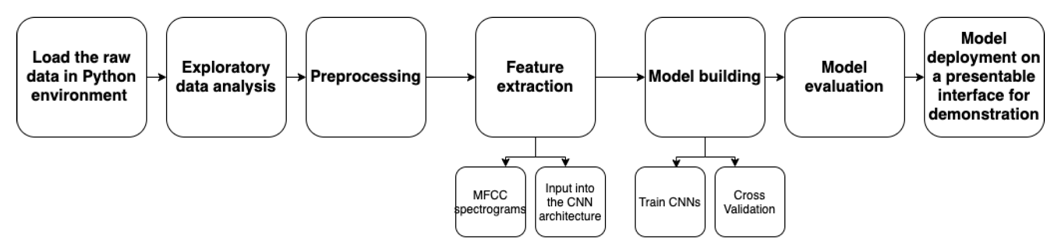
Technical Approach
Technical Approach
Train a deep convolutional neural network on carefully extracted visual representations of each of the audio samples to address the task of environmental sound classification.
Analyze the audio files and extract attributes like the number of audio channels, sample rate and bit-depth.
Preprocess the data and extract MFCC spectrograms.
Use cross validation to train the CNN and tune its hyperparameters.
Experiment with transfer learning and other architectures
Utilize cross validation accuracy to choose the best model
Workflow

Slide 8
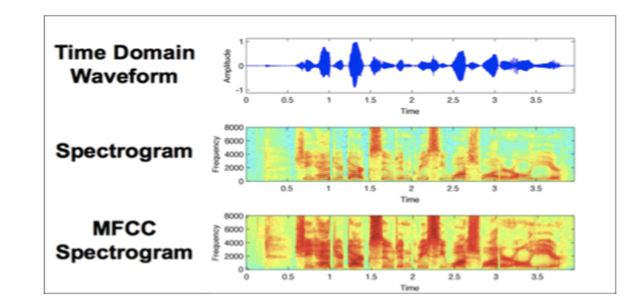
Technical Approach
Spectrograms are one of the most popular techniques for visualizing the spectrum of frequencies of a sound and how they vary during a very short period. We used a similar technique known as Mel-Frequency Cepstral Coefficients (MFCC), which has recently become a highly recommended technique in the domain of audio analysis.
The ability of deep convolutional neural networks (CNN) to learn discriminative spectro-temporal patterns makes them well suited to environmental sound classification compared to other approaches. CNNs by design do well in learning patterns inside images which turns out very helpful in this scenario as MFCC spectrograms are very efficient image representations of audio.

Slide 9
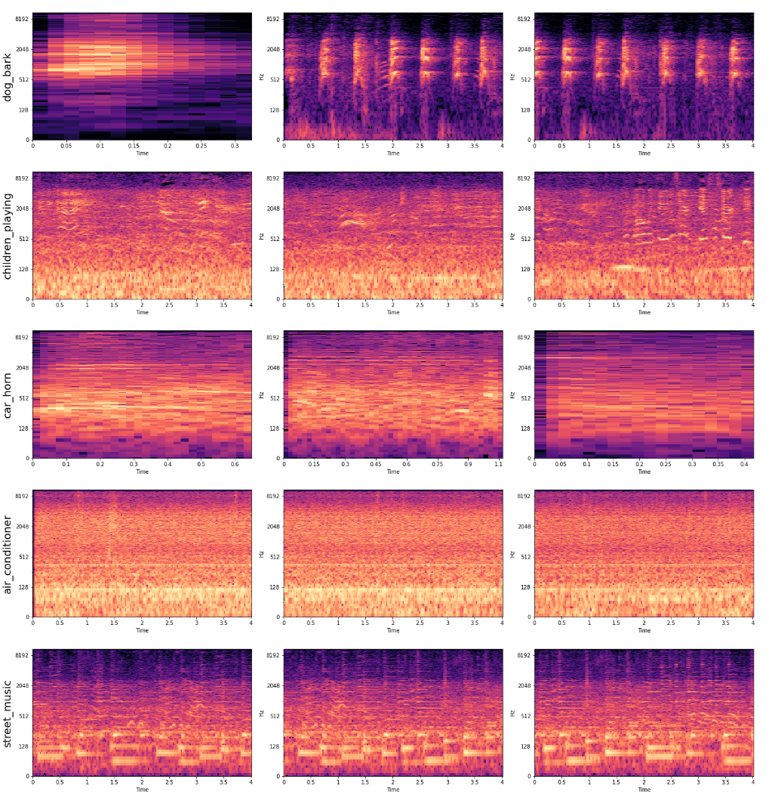
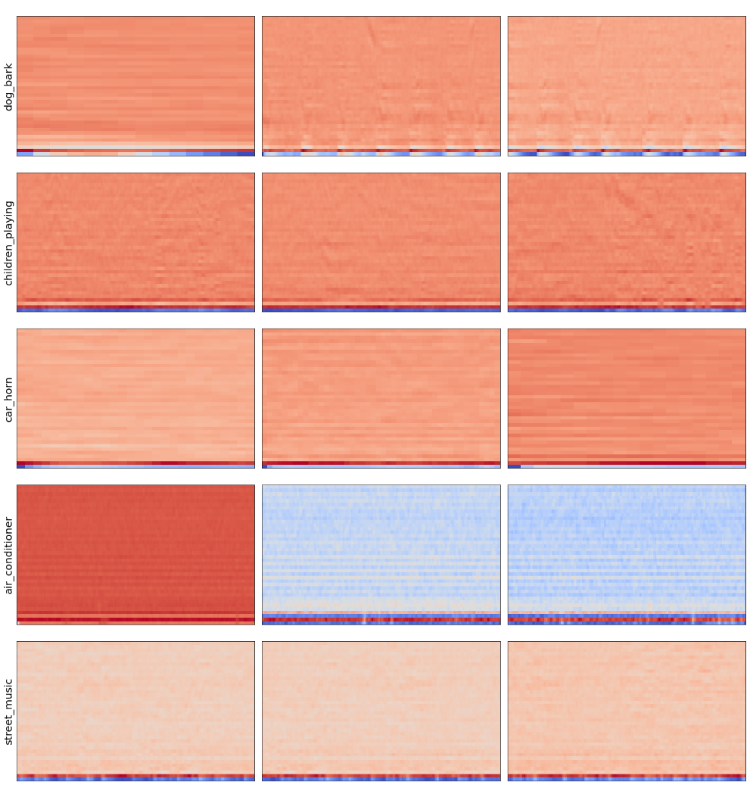
Feature - visualization
Spectrograms
40 Mel frequency cepstrum frequencies

Slide 10
Results - Hyperparameter Tuning
The table below summarizes the different model configurations we tried, its performance as well as the various learnings along the way that nudged us towards our best model
Sl. No. | Model Architecture | Hyperparameters | Model performance | Learnings
1 | CNN | 4 convolution layers + 1 fully connected layer kernel_size = 2 num_batch_size = 256 maxpool size = 2 activation = relu dropout = 0.2 optimizer = adam [referred as ‘original architecture’] | CV Accuracy = 83.04% | This is the most basic architecture we tried. Subsequent experimentation was built on this structure
2 | CNN (experiment with kernel_size) | Same as above except kernel_size = 3 kernel_size = 4 kernel_size = 5 | CV Accuracies, 3 - 90.48% 4 - 92.65% 5 - 92.27% | The accuracy increased as kernel size was increased, but peaked at 4. We decided to proceed with 4x4 kernels
3 | CNN (experiment with dropout) | Same as above with kernel_size = 4 and dropout = [0.2, 0.2, 0.5, 0.5]* (*one for each convolution layer) | CV Accuracy = 90.93% | The accuracy decreased by increasing dropout. Dropout was left at 0.2 for all layers
4 | CNN (with augmented MFCC features) | original architecture with kernel_size = 4 | Test Accuracy* = 95.63% | This was our best model with basic architecture
*Test Accuracy - with the augmented data we were running out of compute while doing 10-fold cross validation, so we did a simpler train-test split

Slide 11
Results - Network Architecture
The table below summarizes the different model configurations we tried, its performance as well as the various learnings along the way that nudged us towards our best model
Sl. No. | Model Architecture | Hyperparameters | Model performance | Learnings
5 | VGG16 (transfer learning) | epochs = 30 batch size = 256 | Test Accuracy* = 95.4% | Does not perform better than the basic model (4)
6 | VGG19 (transfer learning) | epochs = 30 batch size = 256 | Test Accuracy* = 94.5% | Does not perform better than the basic model (4)
7 | Densenet121 (transfer learning) | epochs = 30 batch size = 256 | Test Accuracy* = 95.28% | Does not perform better than the basic model (4)
8 | Densenet121 (with augmented MFCC features) | epochs = 30 batch size = 64 | Test Accuracy* = 96.69% | We selected this network as our best model
The results stated above are for our ‘contender models’ only. Besides these, we also experimented with other hyper parameters like optimizers and number of layers etc. but did not receive better results.
We explored RNNs and creating additional features, none of which performed very well
*Test Accuracy - with the augmented data and larger pretrained networks, we were running out of compute while doing 10-fold cross validation, so we did a simpler train-test split

Slide 12
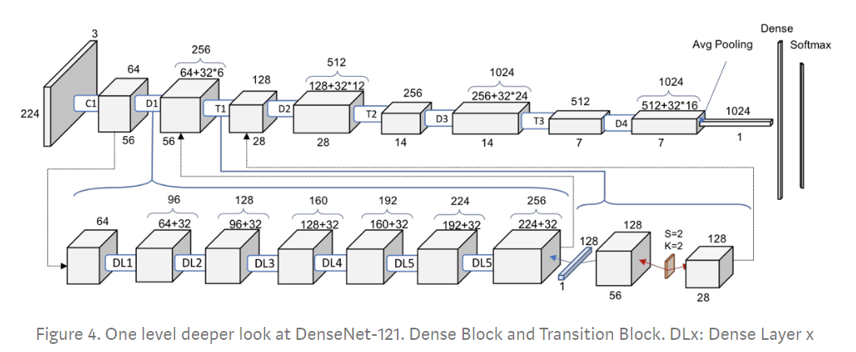
Results - Final Model Architecture
Best model:
Model architecture : Densenet121 with top layer removed, followed by a global average pooling,dropout layer, dense layer(256 nodes) with relu activation dropout layer and a 10 node dense layer with softmax was used.
Model hyperparameters: Batch size = 64(we tried 128 and 256), Number of epochs = 30(within 5 epochs the model had a validation accuracy of more than 90%)
Loss - Categorical cross entropy, Optimizer - Adam, Validation split was 33% on training.
Model performed better than VGG16, VGG19 and MobilenetV2 that also got close results.
Model accuracy: Training accuracy: 97.30 , Testing accuracy: 96.70
Model loss: Training loss: 0.0752 , Testing loss: 0.1071

Slide 13
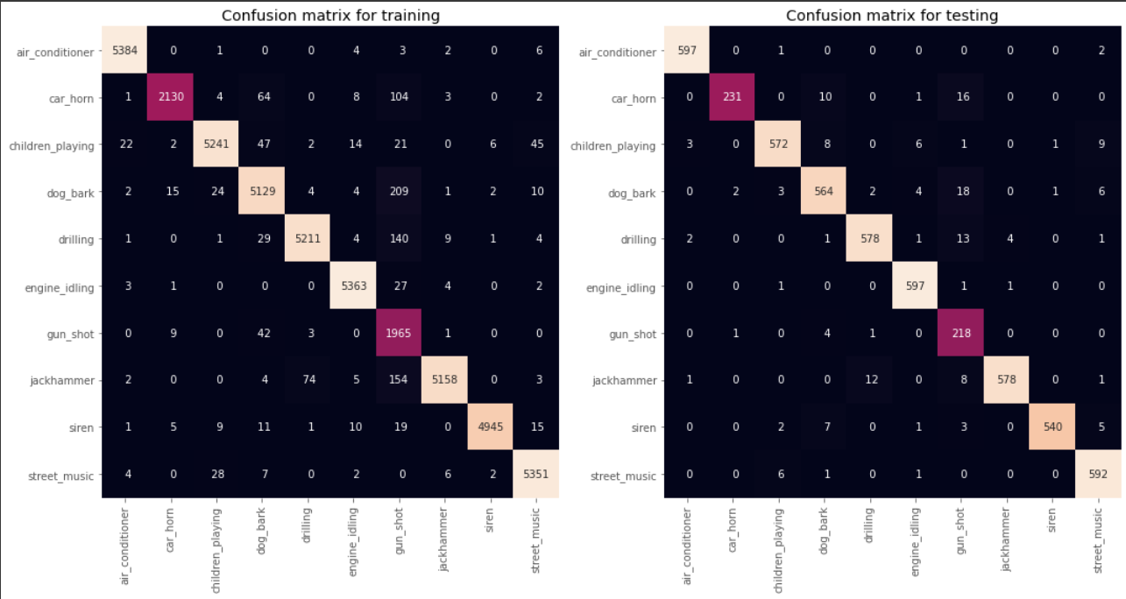
Results - Final Model Performance
As can be seen from the confusion matrix, the model does a pretty good job of classifying the data. Even the minority classes like siren and gunshot have few misclassifications. There seems to be some confusion between car horn, gunshot and dog bark

Slide 14
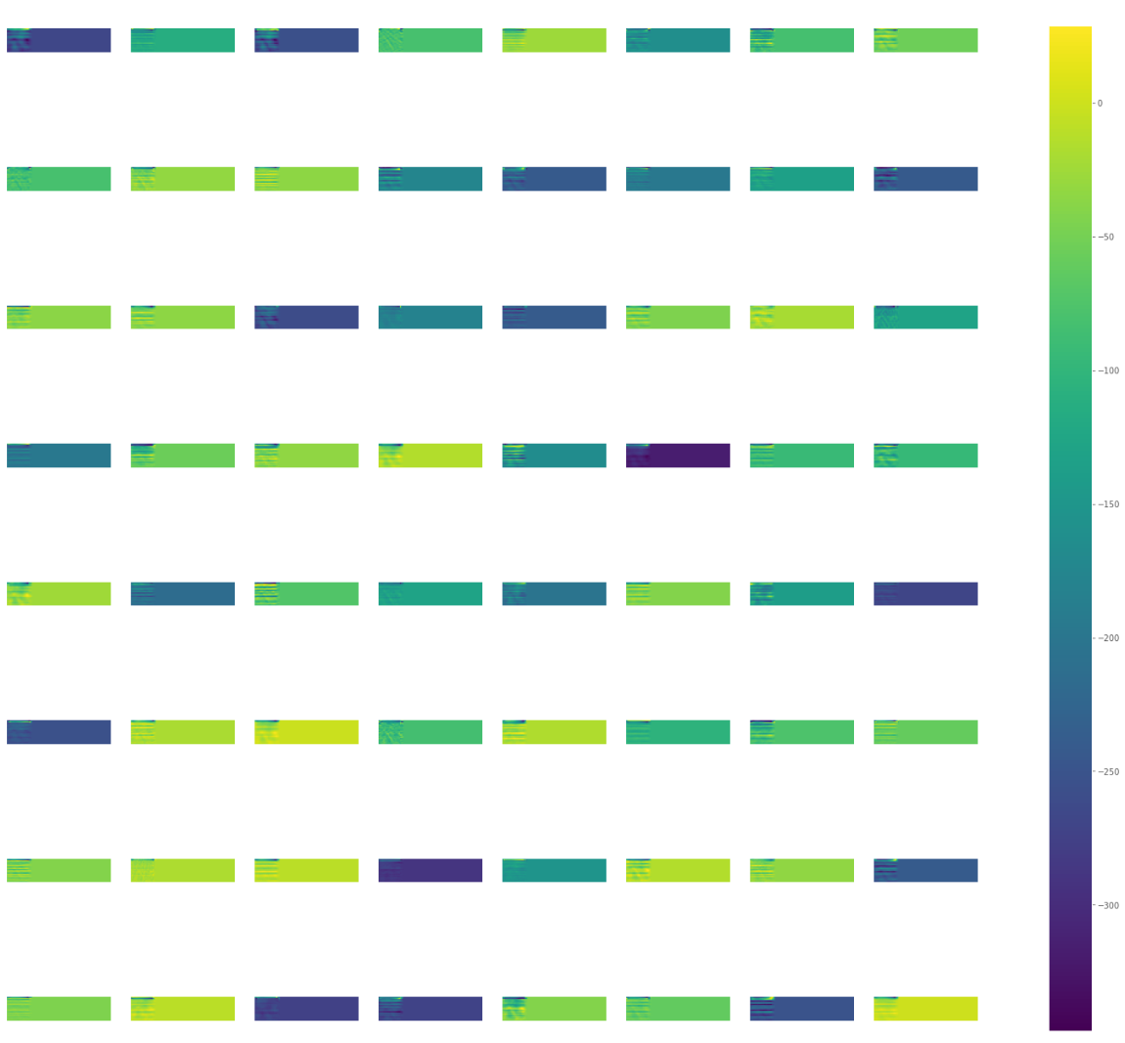
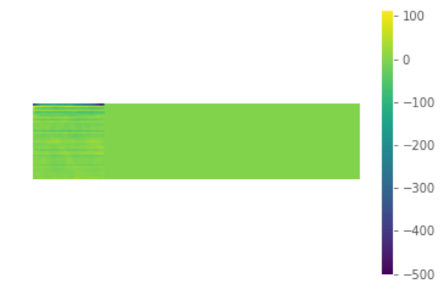
Model activation maps - 1
Conv block 1 activations
Test input - MFCC for drilling audio clip

Slide 15
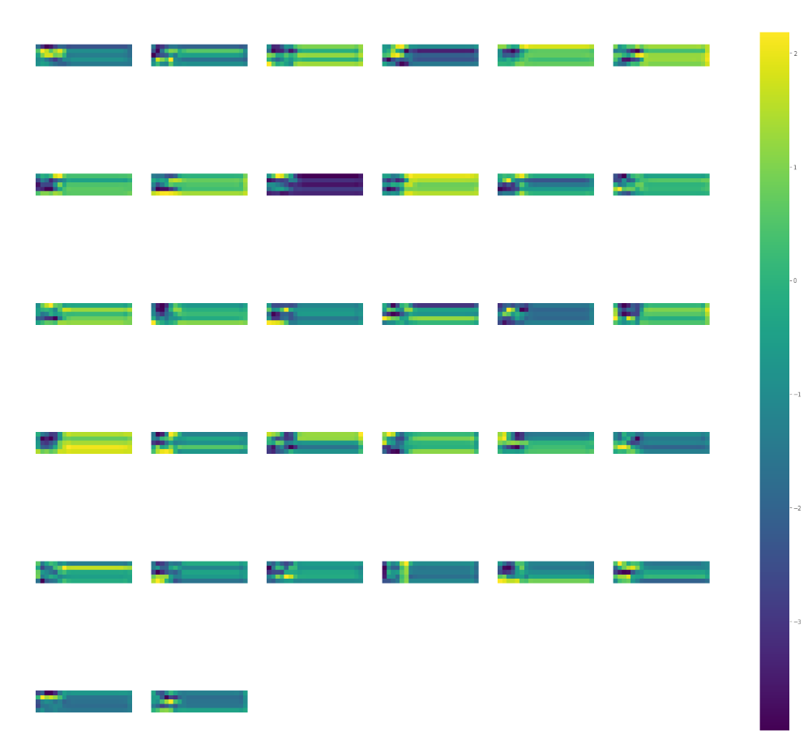
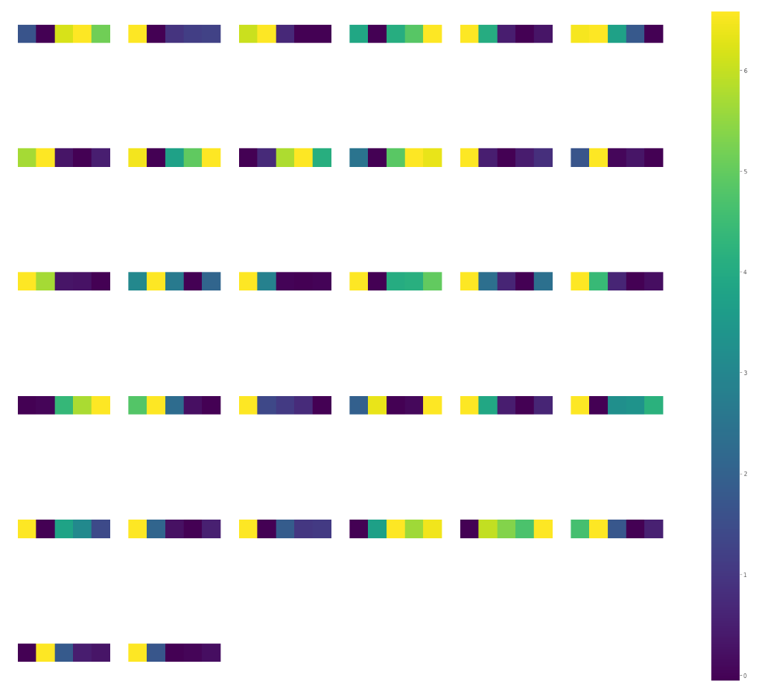
Model activation maps - 2
Conv Block 3 activations
Conv Block 5 activations

Slide 16
Conclusion
Learnings –
From our different experimentations, we reached the following conclusions,
Correcting for the class imbalance by using class_weights significantly improved model performance (from 67% in our MVP to 85% with the most basic network)
4 x 4 kernels are the best suited for this dataset
Data augmentation was very helpful in increasing model performance
Additional features did not add much to classification accuracy
RNNs did not perform as well as CNNs, possibly since MFCCs are time invariant coefficients
Simpler model architectures performed almost at par with larger networks
Limitations of Approach –
Lack of knowledge about what MFCC spectrograms actually mean can result in problems while inspecting the intermediate layer activations of the CNN for diagnosis of signs of poor training.
There can be background noise in a few classes of the dataset, which can hamper training and can be difficult to diagnose.
The case when the audio sample has more than one class like “engine idling” and “car horn” together, our model will not be able to point out both simultaneously
Future Work –
The model can be extended to additional sound classes to better align with practical use cases.
The model can also be extended to multiple sounds in a single clip.

Slide 17
Live demo
Now we are going to present a live demonstration
Taking real time input from the laptop’s microphone we will deploy the model to predict the incoming sounds
Live demo

Slide 18
References
This dataset is available on https://urbansounddataset.weebly.com/urbansound8k.html .
Hand crafted features extracted and CNN-based feature extractor gives a testing accuracy of 73.1 +/- 6.2 ( Recognition of urban sound events using deep context-aware feature extractors and handcrafted features)
Using CNNs on handcrafted features gave a testing accuracy of 87.8% and using Boosting it gave a testing accuracy of 91.9%(What's That Sounds? Machine Learning for Urban Sound Classification ).
VGG with CNN feature vectors of length ≈ 3500 gave a testing accuracy of around 72.86% (https://arxiv.org/pdf/1805.00237.pdf )
Papers:
http://www.justinsalamon.com/uploads/4/3/9/4/4394963/salamon_urbansound_acmmm14.pdf
https://arxiv.org/abs/1608.04363
https://www.ijrte.org/wpcontent/uploads/papers/v7i5s3/E11900275S19.pdf
References of code:
Music Feature Extraction in Python
Audio Classification Using CNN — An Experiment - AI Graduate

Slide 19
Thank you

Slide 20
Appendix

Slide 21
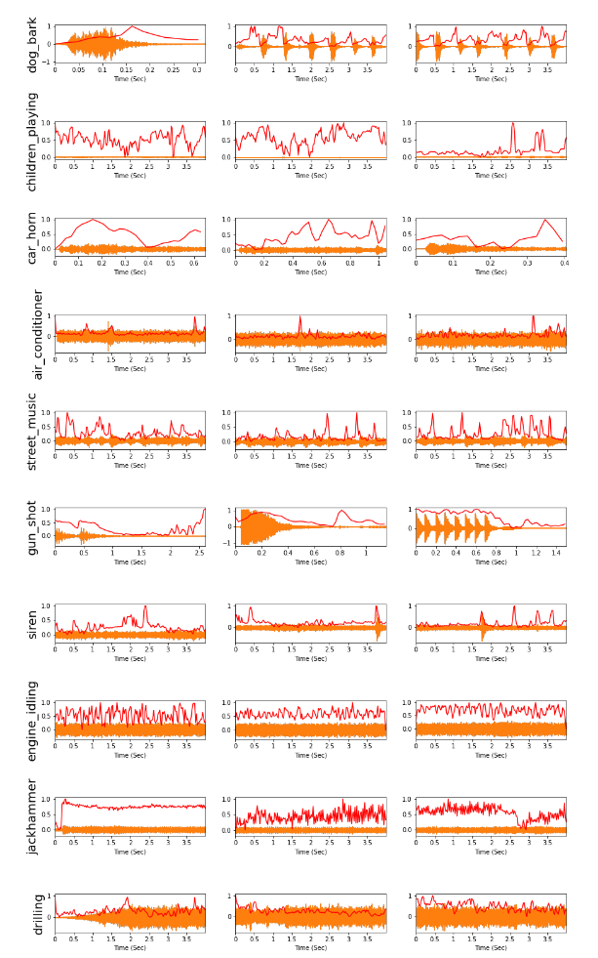
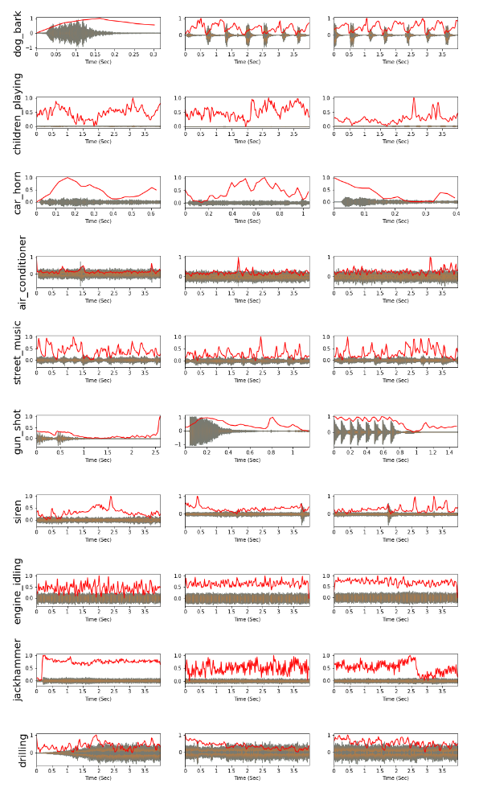
Additional features explored
Spectral centroids
Spectral rolloff

Slide 22
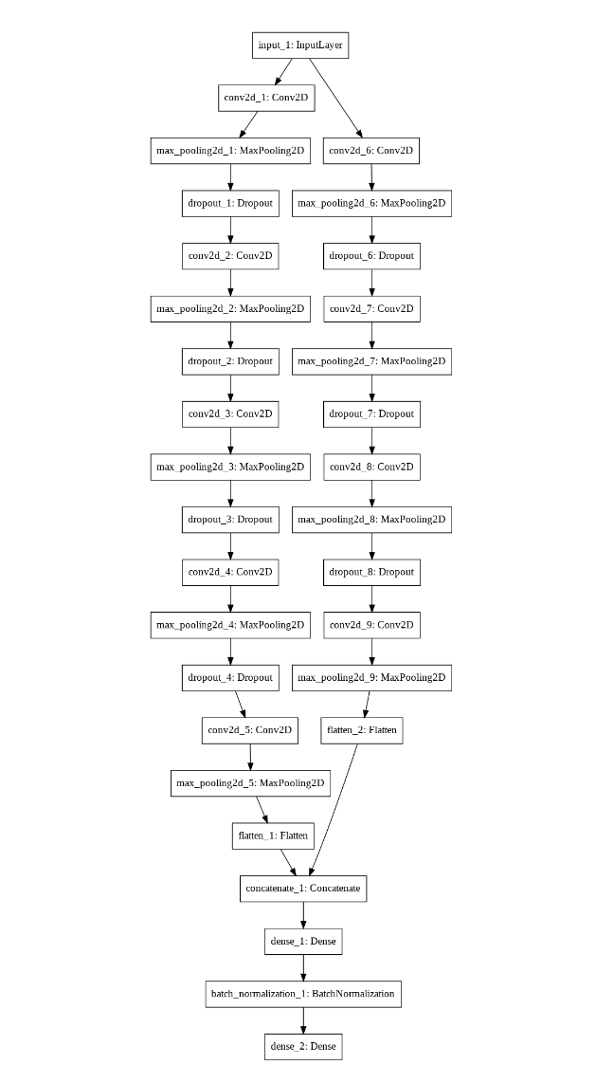
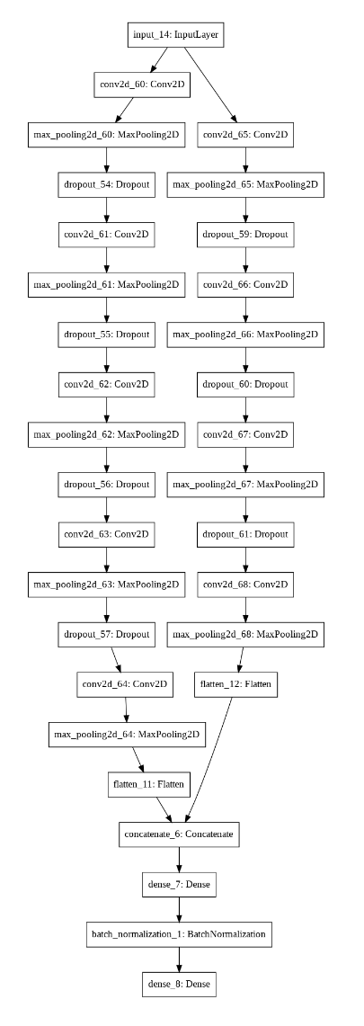
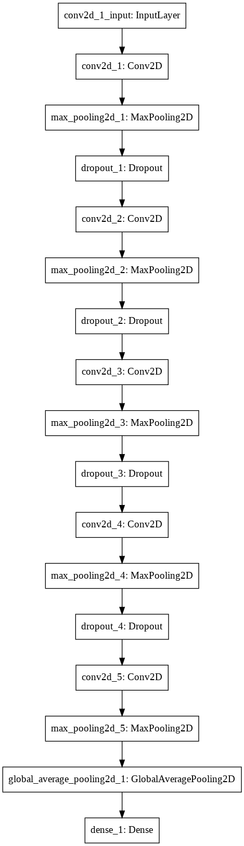
Other model architectures explored

